Slide 1
CHILD CARE Licensing 101:
ALL YOU NEED TO KNOW
Presented by: chantal porte

Slide 2
Learning Objectives
Recognize how the Florida Statutes, Florida Administrative Code, and the Handbook align to protect the health and safety of children in Child Care Programs Statewide
Understand and differentiate how licensing standards shape the daily operations of a Child Care Program
Gain a clear and cohesive understanding of Regulatory Expectations as outlined by DCF and disseminated to Providers.

Slide 3
Legislative Intent
§ 402.26(3), Florida Statutes
To protect the health and welfare of children, it is the intent of the Legislature to develop a regulatory framework that promotes the growth and stability of the child care industry and facilitates the safe physical, intellectual, motor, and social development of the child.
Notes:
Straight from Chapter 402 Section 26 of the Florida Statutes, paragraph 3 reads the intent of the Legislature, which is to develop a regulatory framework that promotes the growth and stability of the child care industry and facilitates the safe physical, intellectual, motor, and social development of the child.
To that end, the Child Care Regulation Program is responsible for regulating programs that provide services that meet the statutory definition of “child care.”
This is accomplished through the inspection of licensed child care programs to ensure the consistent statewide application of child care standards established in statute and rule and the registration of child care providers not subject to inspection.
To meet this legislative intent, the Department developed child care standards for facilities and homes that are detailed in the Florida Administrative Code and Handbooks.
The legislative intent also supports the research, which indicates that children in quality early childhood education programs have better outcomes throughout their lives than children who are not in such programs. The health and safety standards support all areas of children’s development, as well as the environment where care is provided. The standards provide families with options for child care so they are able to make decisions that best align with their goals and needs. The Legislature establishes the intent to protect the health, safety, and well-being of Florida’s children through the establishment of minimum standards of care for Florida.

Slide 4
CHILD CARE DEFINITITION
Section 402.302(1), F.S., defines “child care” as follows: “Child care” means the care, protection, and supervision of a child, for a period of less than 24 hours a day on a regular basis, which supplements parental care, enrichment, and health supervision for the child, in accordance with his individual needs, for which a payment, fee, or grant is made for care.”
If all of the elements are not met, including payment, fee, or grant, then the definition of child care is not met and there is no licensing authority regardless of the ages of the children. In determining "payment" or "fee", a once per year nominal charge would not be considered a payment or fee for the purposes of determining whether or not the definition of child care has been met.

Slide 5
CHILD CARE DEFINITION CONTD.
In terms of a grant, if a program received a state, federal, or foundation grant award to operate a program, that would meet the definition and licensing would be required. If a city or county operated a recreational center as a part of its normal operation and did not charge a payment or fee, the child care definition would not be met and there would be no licensing authority.
It is our policy to look at every program individually to determine licensure status. What a program may choose to call itself, or where it may be located, does not necessarily exclude it from, nor include it in, licensure. It is our responsibility to provide technical assistance to any program to help them understand why their program is, or is not, defined as child care.

Slide 6
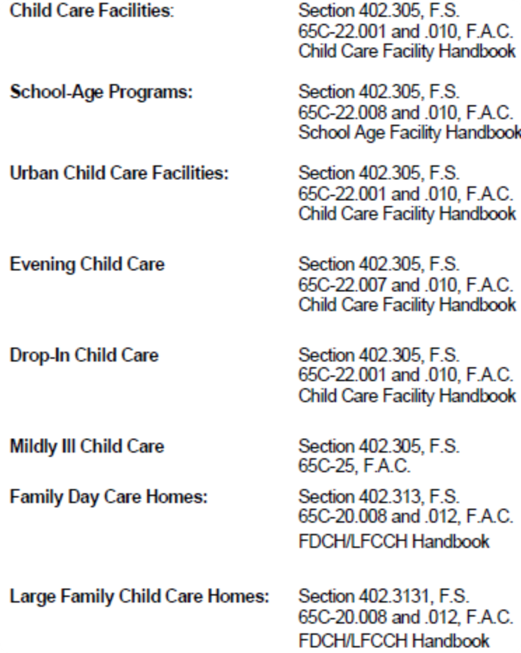
Licensure Requirements
Every program determined to be subject to licensing must meet the applicable licensing standards established by §402.301-.319, F.S., and rules adopted there under.
Notes:
It is very important for all child care providers to know, understand, and follow the laws that govern child care in the State of Florida. Child care laws, rules, and ordinances are in place to protect children, families, and child care professionals.

Slide 7
Florida Statutes
§402.305(1): LICENSING STANDARDS.—The department shall establish licensing standards that each licensed child care facility must meet regardless of the origin or source of the fees used to operate the facility or the type of children served by the facility.
(a) The standards shall be designed to address the following areas:
1. The health, sanitation, safety, and adequate physical surroundings for all children in child care.
2. The health and nutrition of all children in child care.
3. The child development needs of all children in child care.
§402.313(13): The Department shall, by rule, establish minimum standards for family day care homes that are required to be licensed by county licensing ordinance or county licensing resolution or that voluntarily choose to be licensed. The standards should include requirements for staffing, training, maintenance of immunization records, minimum health and safety standards, reduced standards for the regulation of child care during evening hours by municipalities and counties, and enforcement of standards.
§402.3131(7): The department shall, by rule, establish minimum standards for large family child care homes. The standards shall include, at a minimum, requirements for staffing, maintenance of immunization records, minimum health standards, minimum safety standards, minimum square footage, and enforcement of standards.
Notes:
In sections 402.305, 402.313, and 402.3131 of the Florida Statutes, the Department was instructed by the Legislature to establish licensing standards for child care facilities, family day care homes, and large family child care homes that address the following areas…
Health, sanitation, safety, and adequate physical surroundings
Health and nutrition
Child development needs
Requirements for staffing
Training
Maintenance of immunization records
Minimum health and safety standards
Enforcement
Square footage

Slide 8
Florida Administrative Code
65C-22.001(6) Child Care Standards. Child care programs must follow the standards found in the “Child Care Facility Handbook,” October 2021, incorporated herein by reference.
65C-20.008(7) Family Day Care Home and Large Family Child Care Home Standards. Family Day Care Homes and Large Family Child Care Homes must follow the standards found in the “Family Day Care Home and Large Family Child Care Home Handbook,” October 2021, incorporated herein by reference.
Notes:
Chapter 65C-22 of the FAC is the Department’s section of rule that provides the requirements for child care facilities.
In 65C-22.001 (6), F.A.C. the Child Care Facility Handbook is incorporated by rule.
Chapter 65C-20 of the FAC is the Department’s section of rule that provide the requirements for Family Day Care Homes and Large Family Child Care Homes.
In 65C-20.008(7), F.A.C., the Family Day Care Home and Large Family Child Care Home Handbook is incorporated by rule.

Slide 9
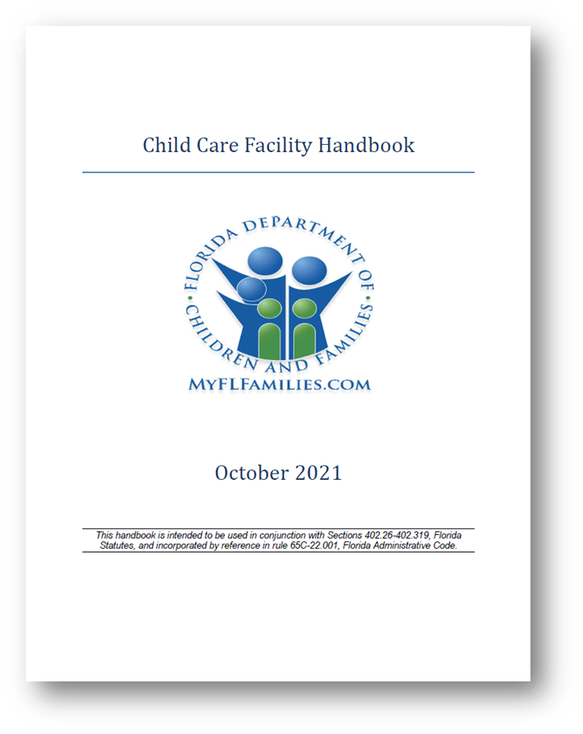
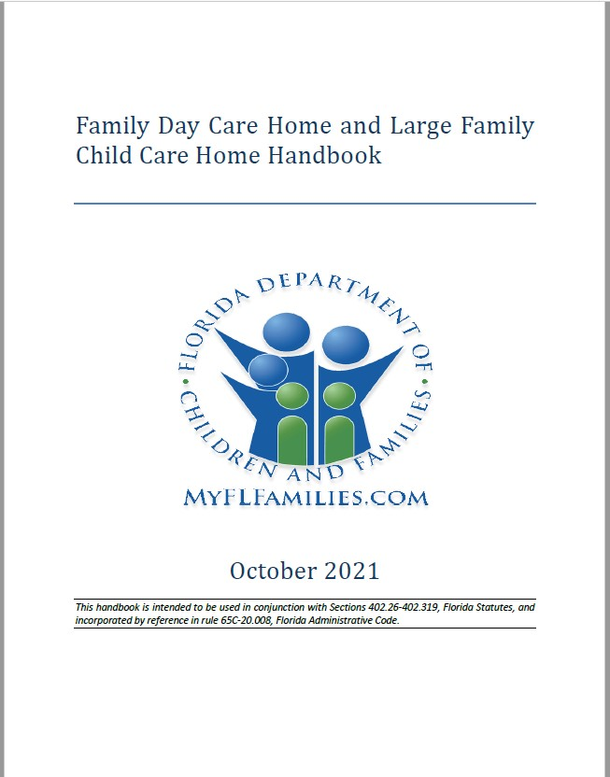
CHILD CARE Handbooks
Notes:
By incorporating the Handbooks by reference in rule, they were able to be written in plain language and organized by topic, so it is easier for providers to find information on licensing requirements.
It is essential, as a child care professional, to take the time to review the official rules and regulations. Remember that these documents are updated when the rules and regulations change, so you should review the Department’s website frequently to stay informed of changes because you are responsible for implementing the current rules and regulations.

Slide 10
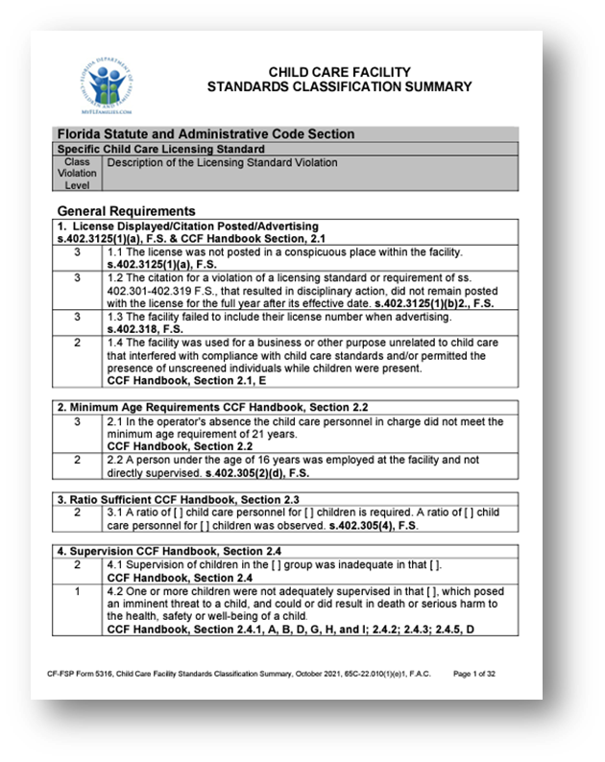
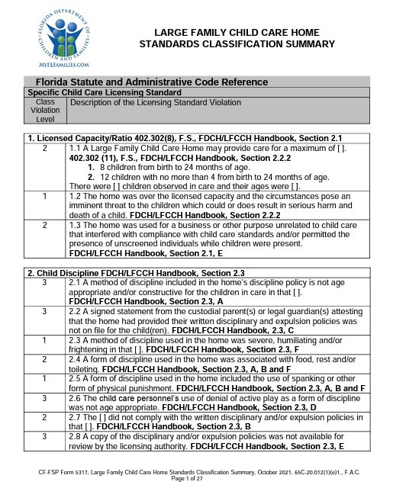
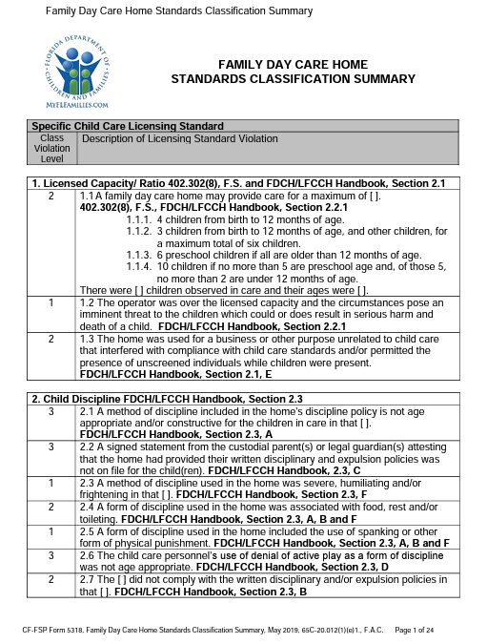
Classification Summaries
Notes:
The classification summaries are tools that we use to describe licensing standard violations, including what the violation’s class level is.

Slide 11
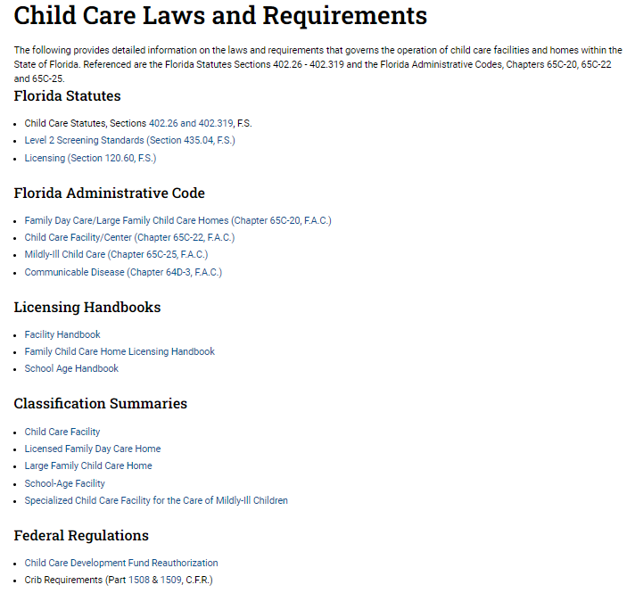
Child Care Licensing
Website
For detailed information on the laws and requirements that govern the operation of facilities and homes within the state of Florida, visit the Child Care Laws and Requirements page of the Department’s website at…
www.myflfamilies.com/services/child-family/child-care/child-care-laws-and-requirements
Notes:
Child care laws, rules, and ordinances are in place to protect children, families, and child care professionals. This class presents information found in the Florida Statutes and rules created by the Department of Children and Families, which are found in the Florida Administrative Code and the Facility Handbook. Child care professionals should learn the local city and county ordinances that impact your program and follow them
as well.
The Department of Children and Families’ Office of Child Care Regulation website lists links to the statewide rules and regulations related to child care. It is imperative to become familiar with all of the documents so you can provide quality care that aligns with the law and protects the health and safety of children. The website is a critical resource for child care professionals. It contains information and resources to help individuals understand and meet the requirements.

Slide 12
Partnering State Agencies
State Fire Marshall
  Focuses on the protection of life, property, and the environment.
Department of Children and Families Background Screening (BGS) Clearinghouse
  Provides a point of contact for BGS results.
Florida Department of Law Enforcement
  Processes child care personnel criminal history records checks—statewide and national– and juvenile checks.
Florida Division of Early Learning
  Administers the School Readiness (SR) and Voluntary Prekindergarten (VPK) programs.
Florida Department of Health
  Conducts health record audits.
Local County Government Agencies
  Includes Zoning and Building Administration and the four counties that require homes to be locally licensed.

Slide 13
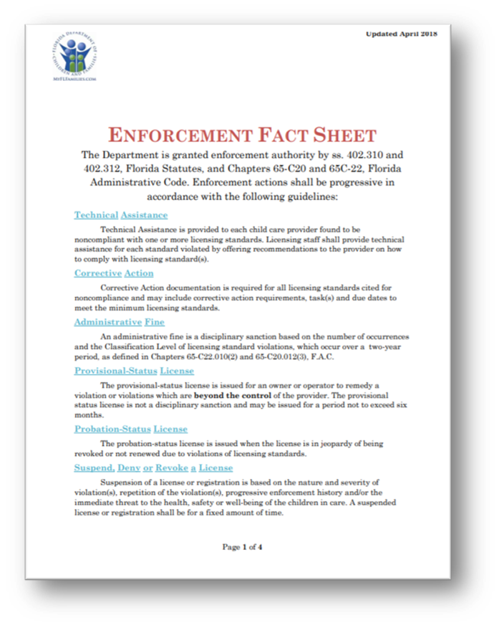
Licensing Violations?
“Violation” is a noncompliance with a licensing standard as described in an inspection report resulting from an inspection under Section 402.311, F.S., as follows with regard to Class I, Class II, and Class III Violations.
Notes:
So… what is a licensing violation?
This is the official definition found in 65C-20.012(1)(e), F.A.C.
A violation is a non-compliance with a licensing standard found during an inspection.
Violations vary from a Class 1 to a Class 3.
A Class I violation is the most serious in nature and is issued when death or serious harm to child could or did occur. With a Class 2 being slightly less serious in nature but having a moderate potential to pose harm to the health and safety of children in care. And the Class 3 is the least serious in nature and has a low potential for harm.
Class I violations are the most serious in nature, pose an imminent threat to a child including abuse or neglect and which could or does result in death or serious harm to the health, safety, and well-being of a child. Some examples of Class I violations include:
-Commission of a serious act of child abuse or neglect on a child
-Leaving a child unattended or with insufficient supervision such that a child leaves the facility/home
-Leaving a child behind in a vehicle at the facility, on a field trip, or an activity away from the facility.
-Administering the wrong medication, the incorrect dosage, or medication without parental authorization to a child
Class II violations are less serious in nature than Class I violations and could be anticipated to pose a threat to the health, safety, or well-being of a child, although the threat is not imminent. Some examples of Class II violations include:
-Non-compliance with staff-to-child ratios
-Lack of direct supervision (provided the violation does not pose an immediate threat)
-Over-capacity
-Improper storage of toxic/hazardous materials
-Harmful supplies/medication not labeled or stored properly
-Fencing violation or other outdoor hazard
And, finally, Class III violations are less serious in nature than either Class I or Class II violations and pose a low potential for harm to children. Some examples of Class III violations include:
-Incomplete first aid supplies
-Violations relating to personnel and children’s records (excluding screening and infant/child CPR/First Aid training)
-Insufficient space between napping children
-Fire drills not documented or completed

Slide 14
Enforcement
Technical Assistance - Provided to each child care provider found to be noncompliant with one or more licensing standards. Can include recommendations to the provider on how to comply with licensing standards.
Corrective Action – Required for all licensing standards cited for noncompliance and may include corrective action requirements, task(s) and due dates to meet the minimum licensing standards.
Administrative Fine – A disciplinary sanction based on the number of occurrences and the Classification Level of licensing standard violations, which occur over a two-year period, as defined in Chapters 65C-22.010(2) and 65C-20.012(3), F.A.C.
Notes:
The Department is granted enforcement authority by ss. 402.310 and 402.312, Florida Statutes, and Chapters 65-C20 and 65C-22, Florida Administrative Code. Enforcement actions shall be progressive in accordance with the following guidelines…

Slide 15
CHILD CARE Inspections
Initial Inspection
Routine Inspection
Abbreviated Inspection
Re-inspection
Renewal Inspection
Complaint Inspection
School Readiness Inspection
Gold Seal Inspection
Notes:
There are eight types of inspections, each of which must be completed and uploaded in CARES 2.
These types of inspection reports are as follows:
Initial Inspection
Routine Inspection
Abbreviated Inspection
Re-inspection
Renewal Inspection
Complaint Inspection
School Readiness Inspection
Gold Seal Inspection

Slide 17
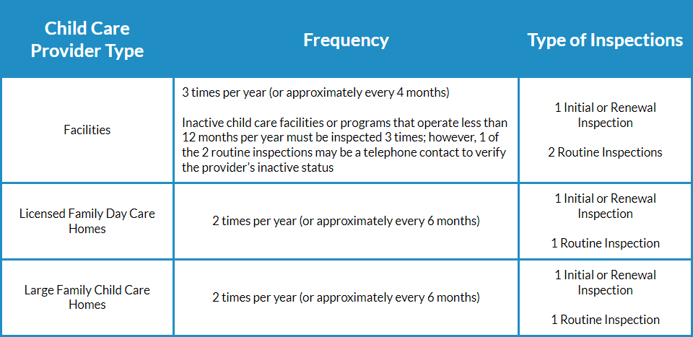
Frequency of Inspections
CCF -
  Three full, on-site, inspections per year, approximately every four months.
    If applicable, an abbreviated inspection can replace a full routine inspection.
FDCH/LFCCH -
  2 full, on-site inspection per year, approximately every 6 months.
    If applicable, an abbreviated inspection can replace a full routine inspection.
Exceptions -
  Inactive providers.
  Programs that operate less than 12 months a year (school-year only).
  Probation status.
Notes:
Inactive providers: They must notify licensing in writing that they will be going non-operational for a period of time.
Full inspection not required during inactive period.
Less than 12 months: Must notify licensing in writing. One of 2 routines inspections may be conducted by telephone during the period the program in closed.

Slide 18
Right of Inspection
§402.311, F.S.
Every child care provider is required to allow the Department access to facilities, personnel, and records at reasonable times, during regular business hours, to ensure compliance with Section 402.301 through 402.319,F.S.
Notes:
The Department conducts inspections for every type of licensed child care provider, including Gold Seal and School Readiness providers.
Licensed exempt providers are also inspected by the Department if they participate in the School Readiness program or hold a Gold Seal.
Licensed providers must allow the Department or the local licensing agency access to facilities, personnel, and records at reasonable times and during regular business hours.
They also must not interfere with or prevent licensing from copying records, photographing or recording a location or activity on the premises as documentation for the inspection.
Application for a license or renewal or advertising the provision of child care to the public constitutes permission for entry and inspection of the child care program premises.
The right of entry and inspection also extends to any premise which the licensing authority has reason to believe is being operated or maintained as a child care facility without a license or exemption.
However, in the case of an illegal operation, the licensing authority must either have the permission of the person in charge of the premises or authorization in the form of a circuit court order prior to entry or inspection.
The Department or local licensing agency may institute disciplinary proceedings pursuant to s. 402.310, F.S., for refusal of entry.

Slide 19
Helpful Hints…
All child care providers are required to keep current, well-organized, and up-to-date files, postings, written policies, records, and other documentation for children in care, employees, and their own child care program.
Each of the records required must be maintained at the program location and must be available during the hours of operation for review by the licensing authority.
Copies of required records are acceptable for documentation. Original documents are the property of the party providing the information. Electronic records are acceptable for documentation as long as the records are available and accessible for review by licensing authority during an inspection.
Notes:
Child Care Facility Handbook, Section 7, Record Keeping (p. 57 – 59)

Slide 20
Personnel Records
Background Screening and Personnel Requirements Form [CF-FSP 5131]
Child Abuse and Neglect Reporting Requirements Form [CF-FSP 5337]
Attestation of Good Moral Character [CF-FSP 1649A]
Application for Employment with Supplemental Statements
Level II Background Screening
Employment History and Verification
Child Care Training Transcript
Documented proof of fire extinguisher training
Documented proof of Universal Precautions/Exposure Plan training
Documented proof of safe sleep practices and shaken baby syndrome training*
Documented proof of CPR/First Aid training*
Documented proof of medication administration training*
Documented proof of transportation training*
Child Care In-Service Training Record [CF-FSP 5628]
*If applicable to the program
Notes:
Level II BGS:
Clearinghouse:
5years employment history
& Verification:

Slide 21
Children’s Records
Child Care Application for Enrollment Form [CF-FSP 5219] or equivalent
  Signed custodial parent/legal guardian statement(s) acknowledging receipt of the program’s disciplinary and expulsion policies
  Signed custodial parent/legal guardian statements acknowledging receipt of the Department's child care facility brochure, "Know Your Child Care Facility," [CF/PI 175-24] or the Department’s family day care home brochure, “Selecting A Family Day Care Home Provider” [CF/PI 175-28]
Current Student Health Examination Certificate

Slide 22
CHILDREN’S FILES CONTD..
Current Florida Certificate of Immunization
  Florida SHOTS – Schools & Child Care Centers
Influenza Brochure
Distracted Adult Brochure
Medication Administration Form (When Applicable)
Accident/Incident Reporting Form (When Applicable)
Food Related Activities Form (When Applicable)

Slide 23
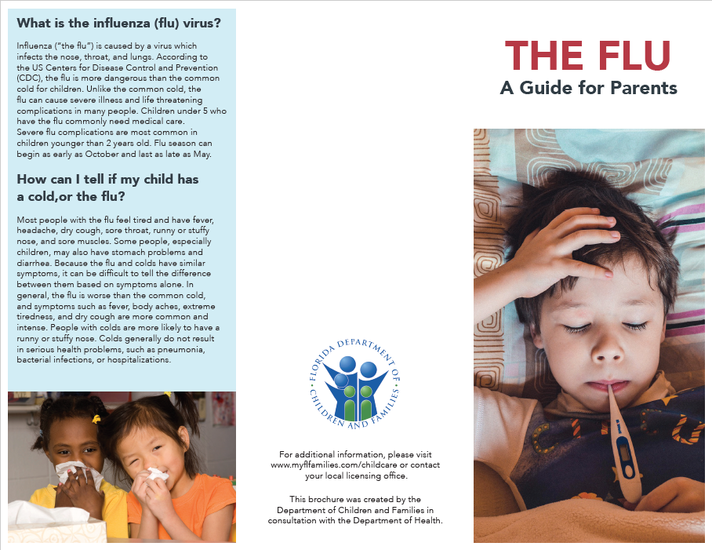
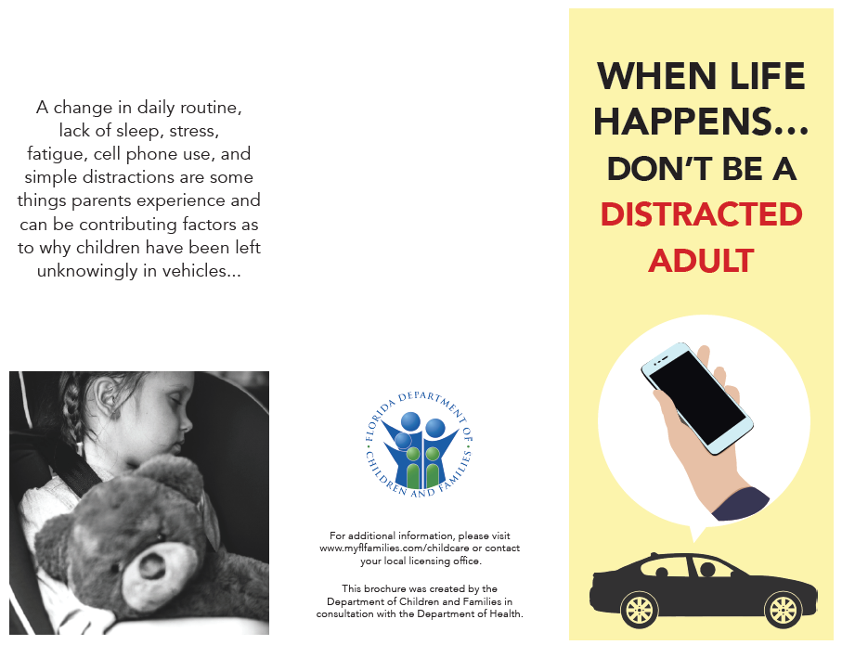
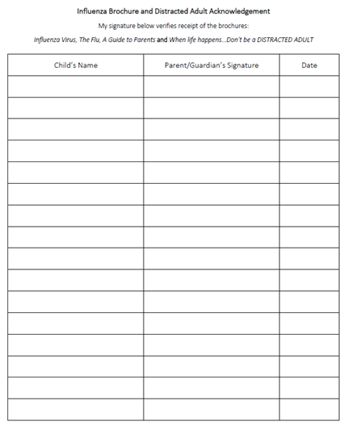
Influenza & Distracted Adult Brochure
Notes:
Influenza Brochure
Provided annually between August or September
Distracted Adult Brochure
Provided during the months of April and September
Please note: Providers have the ability to disseminate these documents via email blasts, newsletters, ProCare, brightwheel etc. Evidence of dissemination will be required by licensing during inspection.

Slide 24
Training Requirements
Mandatory Introductory Training
Early Literacy Training
Safe Sleep/Shaken Baby Syndrome Training
First Aid and Cardiopulmonary Resuscitation (CPR) Certification
Fire Extinguisher Training
Transportation Training
Annual In-Service Training
Medication Training
Universal Safety Precautions Training
Notes:
33 - Training Requirements
CCF Handbook, Section 4
33.1 – 33.12.3
When child care staff are knowledgeable in health and safety practices, programs are more likely to be healthy and safe. The American Association for Health Education (AAHE) and the National Commission for Health Education Credentialing (NCHEC) research data supports that there is an increased quality of children’s health and safety in the child care center environment when staff have been properly trained in health and safety related topics.
Training ensures that staff members are challenged and stimulated, have access to current knowledge and have access to education that will qualify them for new roles. Better trained staff are more equipped to prevent, recognize and correct health and safety issues. Training enhances staff competence and aids in the understanding of how young children learn and grow to their fullest potential. The training/education of caregivers/teachers is a specific indicator of child care quality. Untrained staff may simply “tend” to children, protecting them from harm but not providing challenging, developmentally appropriate activities.

Slide 25
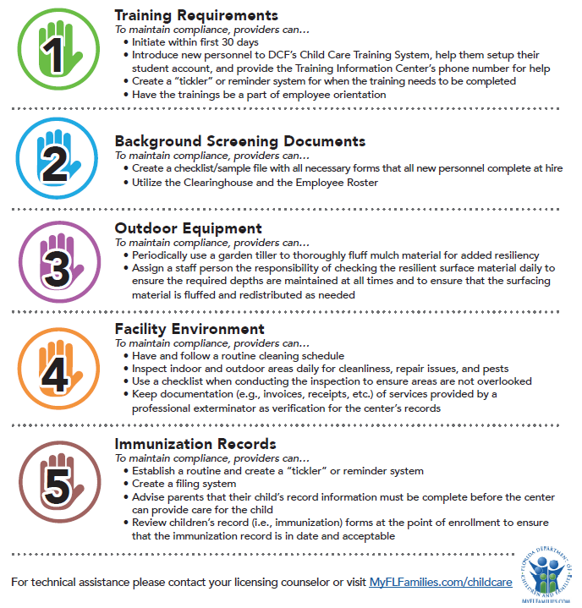
Top 5 Violations
Notes:
Provide simple tips on how avoid some of these Pitfalls
Daily Classroom/Facility Inspection
Observing on all “fours”
Daily “fluffing of Mulch”
Assign/Delegate one staff member o review files/and or review based on a schedule to stay on top of expirations
Observe classrooms
Provide trainings for Staff (Utilize the ELC and their resources)
Reach out to Licensing counselor/licensing office frequently for clarifications or guidance

Slide 26
Trending Violations
Overall, Supervision & Ratio are the resounding top 2 alleged violations across the board.
Since we started the log in October 2022, there have been 824 complaints logged w/ follow-up including both online and from the regions inputting.
The top alleged violations of complaint are:
Supervision – 127
Ratio – 114
General Health & Safety – 86
Illegal Operation – 70
Abuse & Neglect – 64
Supervision & Ratio account for almost 30% of all logged complaints since October 2022.
For 2023 alone the out of 337 logged complaints, the top alleged violations are:
Supervision – 66
Ratio – 52
Access/Child Safety – 30
Abuse/Neglect – 28
General Health & Safety – 27
Supervision & Ratio account for 35% of all logged complaints for 2023.
*Southern and Suncoast have not utilized the complaint log frequently. Much of this data is based on Central, NE, NW & online complaints received.
ONLINE COMPLAINTS ONLY INFO:
Out of 940 Online Complaints for FY 22-23, the top alleged violations are:
Ratio - 273
Supervision - 255
Accident/Incident - 132
Illegal Operation - 105
Discipline – 95
Supervision & Ratio account for 56% of all logged complaints for FY 22-23.
Of 269 logged Online Complaints for 2023, the top alleged violations are:
Supervision – 71
Ratio – 65
Accident/Incident - 35
Discipline - 27
Illegal Operation – 26
Supervision & Ratio account for almost 51% of all logged online complaints for 2023.

Slide 27
TECHNICAL ASSISTANCE VS. HEALTH & SAFETY
Technical Assistance
Flexibility
Resources Provided
One-on-One & Group Trainings
Healthy & Safety
Non-negotiable
TA still Provided & Notated (Always)

Slide 28
Online applications & resources
About Child Care Licensure | Florida DCF (myflfamilies.com)

Slide 29

Questions?

Slide 30
Licensing Staff
Regional Manager
chantal.porte@myflfamilies.com

